Slide 1

NLP Modeling for Aircraft Maintenance
Deepa Mahidhara
May 17, 2019

Slide 2

Context
DEFERRED
ACTION
MAINTENANCE
ISSUES
MAINTENANCE
LOGS
ACTION
RECOMMENDATION
Written up:
By Crew members
By Technicians
During various stages of the operations
Need to be addressed by technicians to keep the aircraft in service
Varying levels of expertise
IMMEDIATE
ACTION
DELAYS/
CANCELS
Process for troubleshooting maintenance logs is very manual, time-consuming, and prone to human errors

Slide 3

Problem Statement
Build a Machine Learning model to:
Read maintenance logs
Convert them to machine-readable language using NLP techniques
Predict an action based on historical data
Benefits
Speed up the maintenance process
Reduce human errors
Reduce airline delays & cancellations

Slide 4
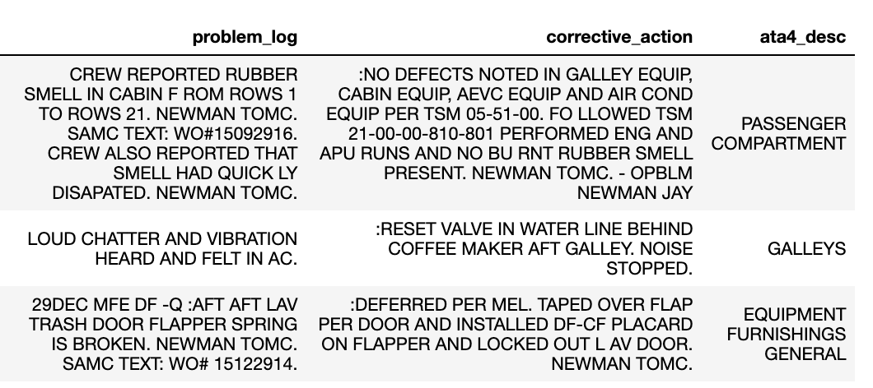
Example: Original Text
Airline has classified logs into broad descriptions using historical relationship between logs & actions; objective here is to build a model to predict action

Slide 5
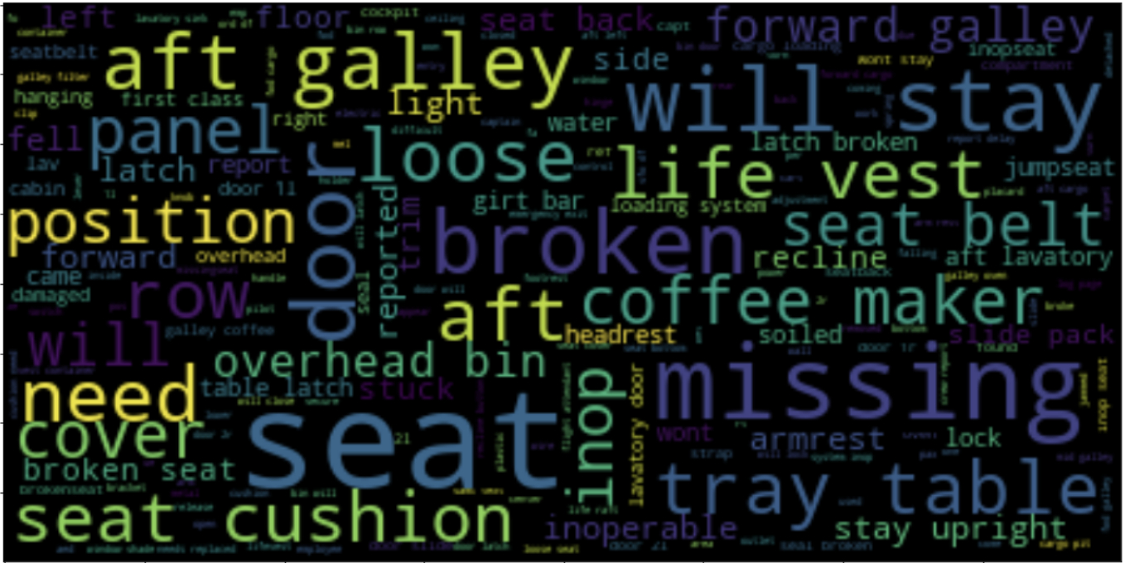
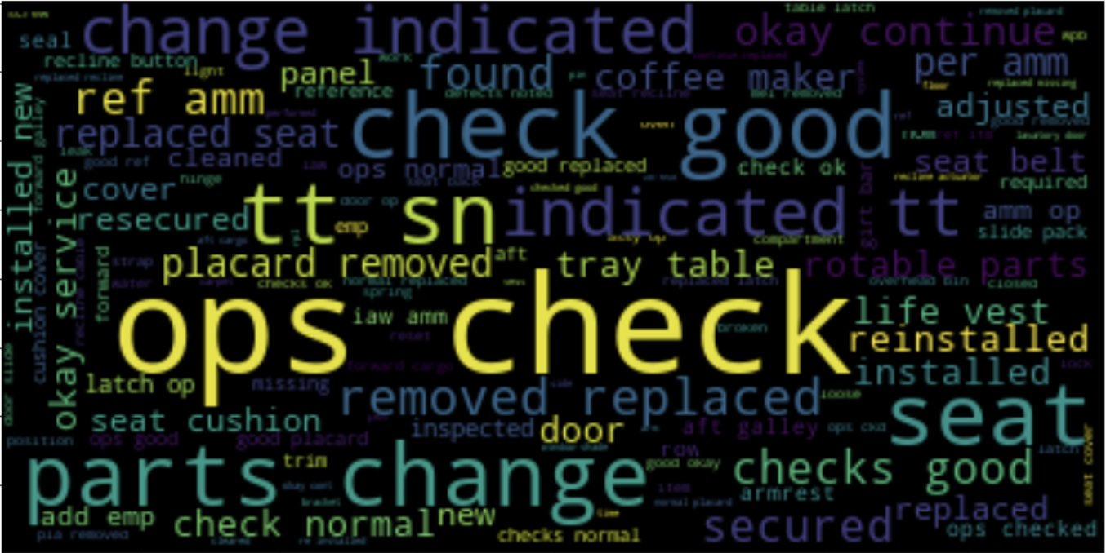
Problem
Log
(More Nouns)
Corrective
Action
(More Verbs)

Slide 6
Model Workflow
Most Similar Log
Corres-ponding Corrective Action
Action
Prediction
New Problem
Log
Nouns
NLP
Modeling
Historical
Logs &
Actions Taken
Verbs
Exploratory Data Analysis
Use Cosine Similarity to match text, and SpaCy part-of-speech tagging to identify nouns and verbs

Slide 7
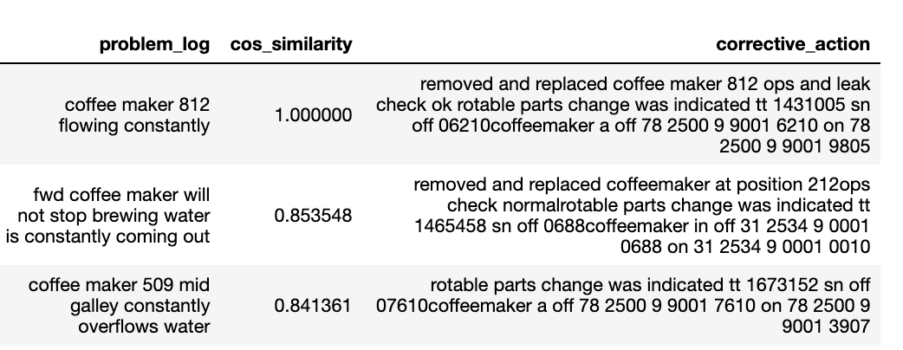
Using Cosine Similarity
PROBLEM LOG: [coffee maker 812 flowing constantly]
Identify historical log with highest cosine similarity and find corresponding action

Slide 8
Using SpaCy Part of Speech Tagging
PROBLEM LOG | NOUNS and VERBS
coffee maker 812 flowing constantly | Noun phrases: ['coffee maker’] Verbs: ['flow']
CORRECTIVE ACTION | NOUNS and VERBS
removed and replaced coffee maker 812 ops and leak check ok rotable parts change was indicated tt 1431005 sn off | Noun phrases: ['coffee maker’] Verbs: ['remove', 'replace', 'be', 'indicate']

Slide 9
Examples of Predictions
Problem Log | Cosine Similarity | Action Prediction
'SEAT 27C NEEDS NEW SEAT CUSHION COVER' | 0.93 | 'replace', 'seat', 'new cushion', 'cover'
'COFFEE MAKER 420 WILL NOT SHUTOFF.' | 0.91 | 'remove', 'replace', 'work', 'ok', 'be', 'indicate', 'coffee maker'
AFT GALLEY COFFEE MAKER LEAKING.ENTERED INTO SCEPTRE FOR EMPLOYEE #0080038.' | 0.74 | 'perform', 'check', 'galley coffeemaker leaking note', 'sceptre', 'flight crew employee'
'FIRST OFFICERS OXYGEN MASK HARNESS WILL NOT INFLATE' | 0.71 | 'straighten', 'first officers seat belt buckle', 'shoulder harness'
*Corrective action text is has many more words than problem logs, needs more parsing

Slide 10

Next Steps
Classify actions into deferred and immediate
Create a corpus of tech words
Continue to enhance NLP model to:
Better model time & numerical data
Identify specific topics
Investigate logic for selecting best nouns and verbs

